Slide 1
Bayesian Research Kitchen
  Neil Lawrence

Slide 2
Overview
Background
Issues
Arrangements

Slide 3
Background

Slide 4
Thematic Programme
Workshop is part of a thematic programme on
  “Leveraging Complex Prior Knowledge”
Something Bayesians should be good at!
History of Workshop
  Sparse GP Workshop by Chris Williams in Edinburgh, 2003?
  Manfred at end “We should do this more often”
Gaussian Process Round Table, June 2005.
  Energetic and lively, lots of progress.
The perspective then was ...

Slide 5
Life of Brian
Brian: Are you the Judean People's Front?
Reg: F--- off.
Brian: I didn't want to sell this stuff. It's only a job. I hate the Romans as much as anybody.
Reg:Judean People's Front. (scoffs) We're the People's Front of Judea. Judean People's front, caw.
Brian: Can I join your group?
Reg: Listen. If you really wanted to join the PFJ, you'd have to really hate the Romans.
Brian: I do.
Reg: Oh yeah? How much?
Brian: A lot!
Reg: Right. You're in. Listen. The only people we hate more than the Romans are the f---ing Judean People's Front

Slide 6
Life of a Research Student
Student: Are you Frequentist statisticians?
CKIW: F--- off.
Student: I didn't want to research this stuff. It's only a job. I hate Fuzzy Logic as much as anybody.
CKIW: Frequentist statisticians. (scoffs) We're Bayesian statisticians.
Student: Can I join your group?
CKIW: Listen. If you really wanted to join the Bayesians, you'd have to really hate Fuzzy Logic.
Student: I do.
CKIW: Oh yeah? How much?
Student: A lot!
CKIW: Right. You're in. Listen. The only thing we hate more than Fuzzy Logic is the f---ing Frequentists.

Slide 7
GPs in Machine Learning
Lessons from history.
Betamax in videos (Sony)‏
  Better technical specification.
  Survived as a professional format.
VHS in videos (JVC)‏
  Longer tapes and faster rewind in early machines.

Slide 8
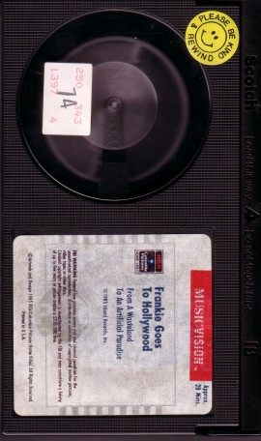
SVM and GPs
We believe in GPs.
Can learn kernel parameters.
Easy to extend
  e.g. multi-task learning.

Slide 9
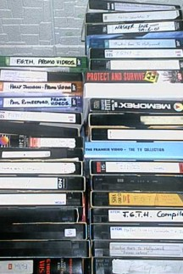
SVMs
SVMs offer
Naturally sparse solution.
O(Nd²) learning complexity. Typically d<<N.
A sexy, simple and ?misleading? explanation of how they work.

Slide 10
Today's Issues

Slide 11
Issues
Was GPRT Successful?

Slide 12
Issues 1
What do we have to worry about now?
  Workshop Themes
Zoubin's talk yesterday:
  Science/Engineering
  Carl: we spend all this time on inference, but can we separate it from decision.

Slide 13
My Worry
Phil Dawid:
  “The Bayesian Jungle is now cultivated land ...”
The Bayesian Framework is v. powerful.
  Are we so excited about the things it can do (better than competitors) that we miss the things it can't?

Slide 14
Thanks to
PASCAL II and Microsoft Research for funding.

Slide 15
Format
Formally: 45 minute talks, followed by 15 minutes of discussion.
Practically: Format as for Zoubin's talk last night.
Questions?

